Slide 1
Your Portfolio
What it is and how to develop it

Slide 2
Not to worry!
You have already been working on these; you have done much! (You don’t realize it.) Just carry on!
I have seen many students worry about portfolios …
… but I have seen many brilliant portfolios!
… and have never seen a ‘bad’ one!

Slide 3
So, what is the portfolio about?
The answer is simple as it is profound …

Slide 4
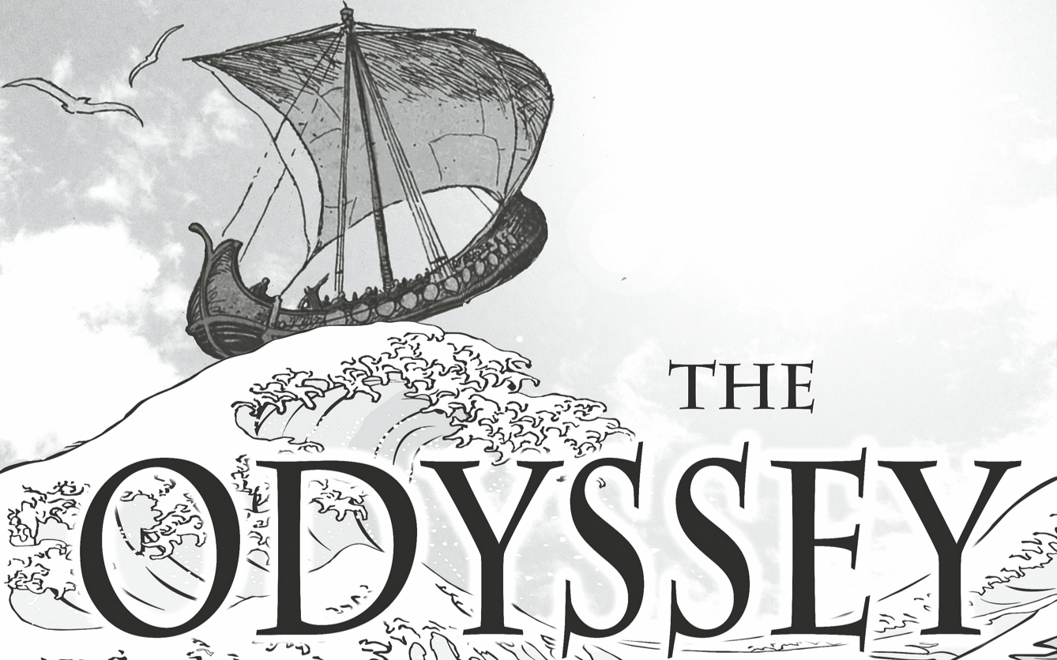
So, what is the portfolio about?

Slide 5
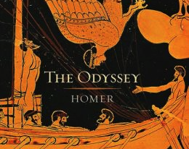
So, what is the portfolio about?

Slide 6
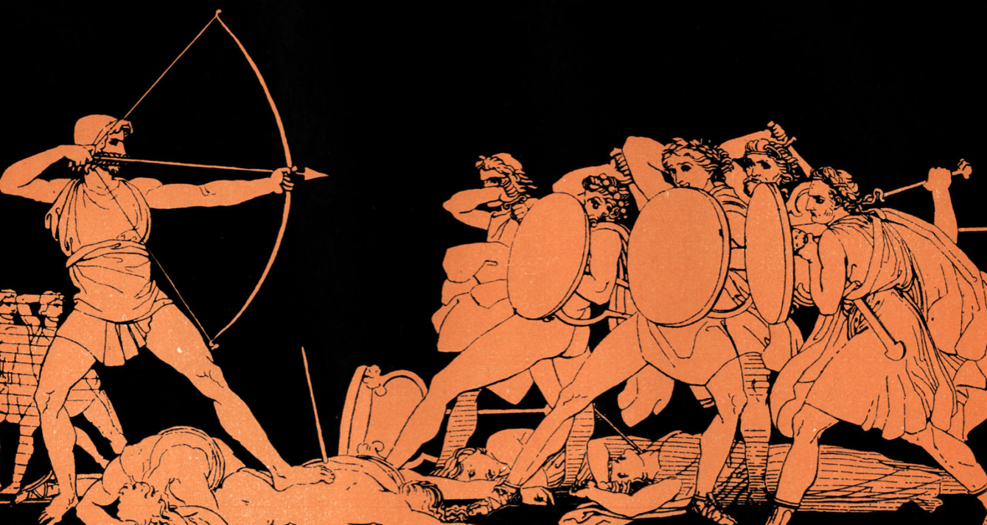
So, what is the portfolio about?

Slide 7
So, what is the portfolio about?
“Tell me, O muse, of that ingenious hero who travelled far and wide after he had sacked the famous town of Troy. Many cities did he visit, and many were the nations with whose manners and customs he was acquainted; moreover he suffered much by sea while trying to save his own life and bring his men safely home ….
… Tell me, too, about all these things, O daughter of Jove, from whatsoever source you may know them.

Slide 8
And, so, again, what is the portfolio about?

Slide 9
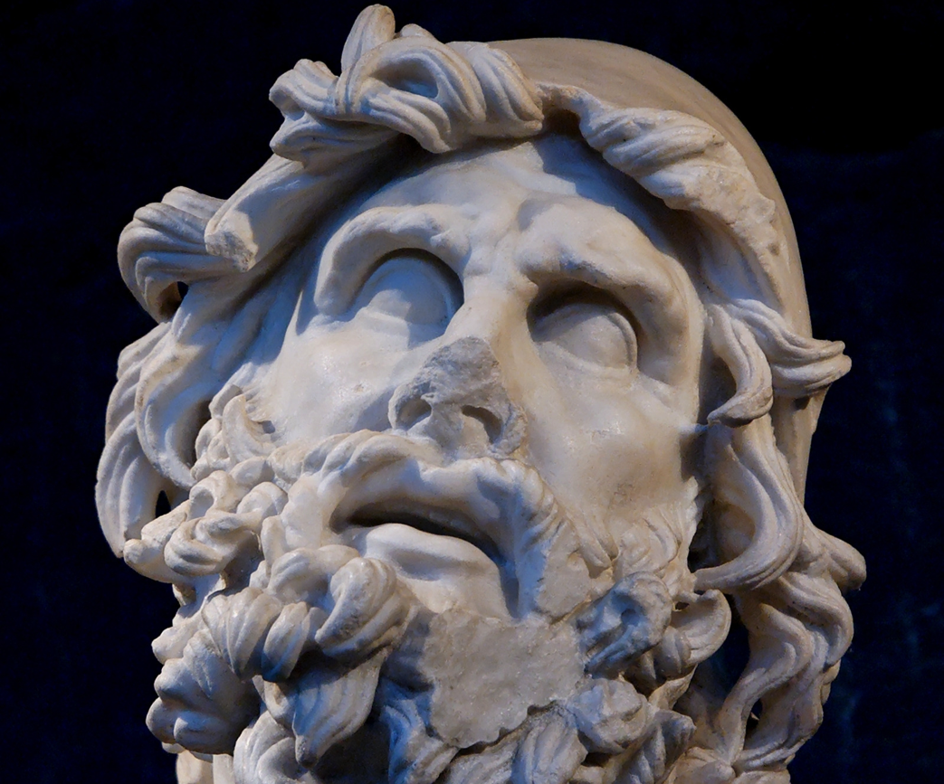
And, so, again, what is the portfolio about?

Slide 10
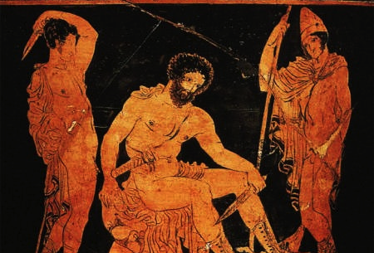
And, so, again, what is the portfolio about?

Slide 11
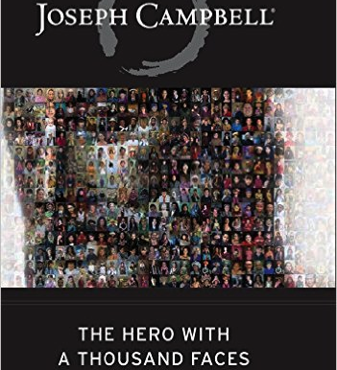
And, so, again, what is the portfolio about?

Slide 12
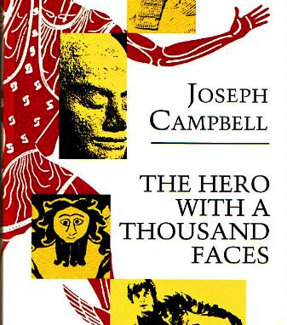
And, so, again, what is the portfolio about?
In narratology and comparative mythology, the monomyth, or the hero's journey, is the common template of a broad category of tales that involve a hero who goes on an adventure, and in a decisive crisis wins a victory, and then comes home changed or transformed.

Slide 13

And, so, again, what is the portfolio about?

Slide 14
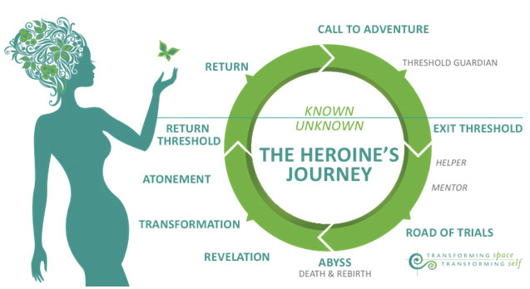
And, so, again, what is the portfolio about?

Slide 15
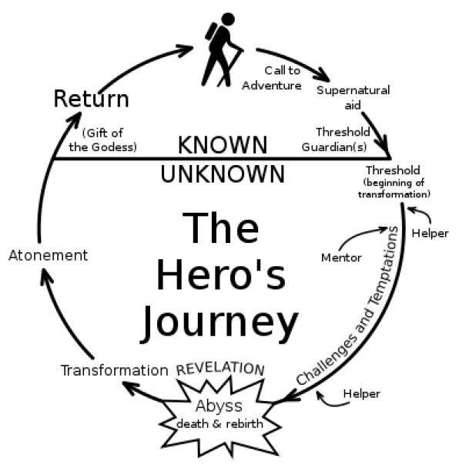
And, so, again, what is the portfolio about?

Slide 16
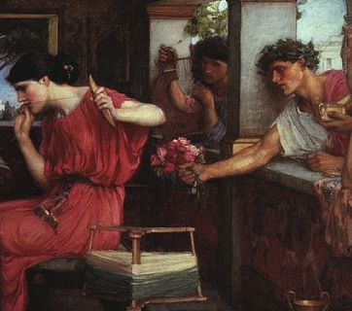
And, so, again, what is the portfolio about?

Slide 17
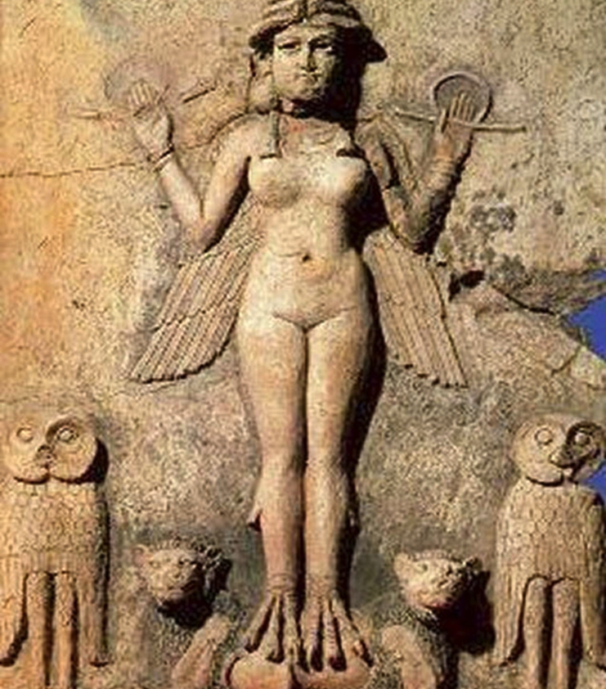
And, so, again, what is the portfolio about?
Notes:
Inanna or Ishtar—ancient Sumerian goddess. her descent into and return from Kur, the ancient Sumerian underworld

Slide 18
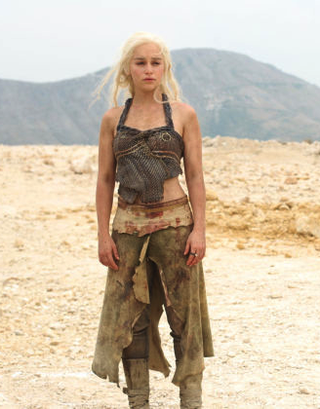

And, so, again, what is the portfolio about?
Notes:
Daenerys Targaryen

Slide 19
And, so, again, what is the portfolio about?
It’s about you.

Slide 20
And, so, again, what is the portfolio about?
It’s about you.
It’s about your becoming.

Slide 21
And, so, again, what is the portfolio about?
“What is my cosmic task?”
“We’re all on a quest and we’re sharing the journey together.”

Slide 22
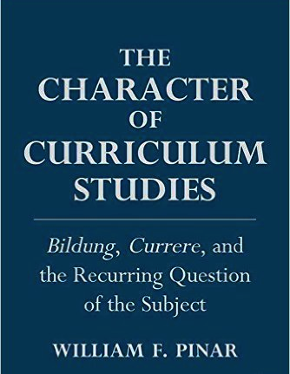

Currere

Slide 23
Currere
Step one: The regressive step—look at the past
Step two: The progressive step—consider your future
Step three: The analytical step--analyzing the here and now
Step four: the synthetic step—put it all together in defining your journey, your currere, your curriculum

Slide 24
Suggestions
There is no one way, magic formula
Since your journey is unique, your portfolio—your record of your journey and discoveries—will be unique
Be creative!
Let your portfolio represent and express the body, aesthetics, emotions and heart, intellect and the head, intuition, spirit

Slide 25
Things to consider including
Theories and ideas and practices that have influenced, inspired, and shaped you in your various courses
Experiences you have had during the program
Resources that have been influential
Understandings, revelations, inspirations, realizations you have had or are having—about leadership, about education, aboutyourself, about anything else you see fit to include

Slide 26
Things to consider including in the portfolio
Text, images, video, audio
The good, bad, and the ugly
The best of times and the worst of times
Ultimately, your journey in and through the leadership program
We have a rubric of areas to consider including; strongly suggest that you follow the rubric.

Slide 27
Okay, the nitty gritty
Your blogs/websites are the housing for your portfolio
As well, you will give a presentation
  You will have about 45 minutes
  You can present however you see fit; we have a rubric
  Use presentation software … or not
  Be performative … and consider allowing your performance itself to be both contemplative and/or a form of inquiry
  Consider offering a one or two page condensation of your portfolio—a fine distillation of your journey and its lessons—the “Executive Summary”

