Slide 1
Writing Skills WorKshop
City University

Slide 2
Beginning—Assessing Your Needs
What are some of the specific questions or concerns you have about writing and writing assignments?

Slide 3
Beginning—Feelings about Writing
What are some of the feelings or emotional responses you have about writing and writing assignments?

Slide 4
Beginning—Feelings about Writing
What are some of the feelings or emotional responses you have about writing and writing assignments?
We all respond in some way(s) to writing

Slide 5
Beginning—Feelings about Writing
What are some of the feelings or emotional responses you have about writing and writing assignments?
We all respond in some way(s) to writing
Think of writing or writing assignments you have loved or hated in the past

Slide 6
Beginning—Feelings about Writing
What are some of the feelings or emotional responses you have about writing and writing assignments?
We all respond in some way(s) to writing
Think of writing or writing assignments you have loved or hated in the past
Our responses, often powerful ones, demonstrate the power of writing itself!

Slide 7
Beginning—Why Do We Write?
List the reasons for writing:
Writing serves as a vehicle to convey the knowledge we have acquired
It forces us to do so in a systematic fashion

Slide 8
Beginning—Why Do We Write?
List the reasons for writing:
Writing helps us organize our thinking
“Pre-writing”—stream of consciousness writing
Mind maps, charts, flow diagrams
Writing as a “technology of the self”
A means of learning more about ourselves
A form of reflective practice that is essential for you as an educator

Slide 9
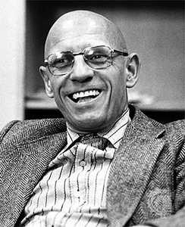
Beginning—Why Do We Write?
Michel Foucault coined the phrase “technologies of the self.”
Writing can serve as a
technology of the self

Slide 10
Beginning—Feelings about Writing
He defines these technologies of the self as
truth games that “permit individuals to effect by their own means or with the help of others a certain number of operations on their own bodies and souls, thoughts, conduct, and way of being, so as to transform themselves in order to attain a certain state of happiness, purity, wisdom, perfection, or immortality.”

Slide 11
Beginning—Feelings about Writing
Cool, huh?

Slide 12
Beginning—Feelings about Writing
Writing can be a technology of the self and it has the potential to play a major role in a “curriculum of the self.”

Slide 13
Beginning—Finding a Topic
Come up with a topic that really interests you.
Make it relevant: “So what?” (Be able to answer that.)
Of personal interest—a ‘burning question’
Connected, as much as possible, to other things you are thinking about with regard to your work here

Slide 14
Beginning—Finding a Topic
What are some of the ways you discover a topic?

Slide 15
Beginning—Finding a Topic
What are some of the ways you discover a topic?
Reading—source of knowledge and inspiration
Discussions and dialogue with others
“Pre-writing”—just writing to clarify your thinking
Paying attention to your feelings and your intuition
Having a burning question that nags you
Observation: paying attention to what is going on around you and within you (reflective practice)

Slide 16
Beginning—Finding a Topic
Trust yourself!
Trust your feelings, intuitions, observations, and lived experience (plus: you are a scholar!)
Feel free to go with your burning questions
Take the opportunity to talk about these with your colleagues—cohort members and faculty—take a risk; be open
“Write the essay for yourself; hand in the essay for the professor.”

Slide 17
Beginning—Finding a Topic
Do your research.
What are some of the sources of information and data you can use in doing your research?

Slide 18
Beginning—Finding a Topic
Do your research.
CityU library—databases; journals and books
Other libraries: public, UBC, SFU
Google Scholar—link to libraries
Scholarly or professional websites on your topic—be discriminating
Conversations with others

Slide 19
Beginning—Finding a Topic
Do your research.
Read and find resources; make connections between authors and ideas; follow trends in thought
Try to get the “big picture” and details
Get at least enough information initially so that you can develop a thesis statement
Organize and manage your information

Slide 20
Beginning—Finding a Topic
Do your research.
Become the world’s leading expert on your topic. Work hard at doing that … and remember that no one else will have the unique experience, knowledge, and perspective that you will have
As a scholar in your Master’s program, you can make a unique and valuable contribution to both knowledge and practice

Slide 21
Know your Audience
Your writing will primarily be academic in nature, following the conventions of academic writing
More formal; avoid colloquialisms
Use of first person is okay! You can choose whether first or third person works for you
Become familiar with academic styles of writing by reading the literature
Feel free to imitate writers whose work you really like

Slide 22
Create an Outline
Before you start writing formally, create an outline that will help you organize your thoughts, ideas, and data
You may need to do some initial (pre-) writing before this to help you get some ideas flowing—writing has that (magic) power to help stimulate and organize your ideas

Slide 23
Create an Outline
All good pieces of writing have three parts:
Beginning
Middle
End

Slide 24
Create an Outline
All good pieces of writing have three parts:
Beginning—Introduction
Middle—Main body of the essay
End—Conclusions and discussion

Slide 25
A Possible Outline
I. Introduction
1. Sentence to get the attention of your readers at the beginning
2. Give background material about your topic, issue, or problem; can include personal data
3. Statement of the problem and purpose of your study/paper/essay
4. Statement of the Research Question or Thesis statement
5. Importance of your work
6. Road map for the reader: indicate for the reader how you are going to structure the paper.
II. Body of the Essay
1. Definitions of terms
2. Theoretical frameworks (theories you will use to explain what is going on):
a. First theory
b. Second theory
c. Third theory
3. Research Findings that support (or not) the theories:
a. Supporting evidence
b. More supporting evidence
c. More supporting evidence
d. Any evidence that goes against this second idea
III. Conclusion (So what does all this mean?)
1. Restatement of your thesis and very brief summary of findings
2. Consideration of the implications of your thesis: how is it significant to your readers and their concerns? What are the implications for teaching & learning, for leaders, for school counsellors, for other educational stakeholders?
3. What recommendations might you make?
4. Final thoughts or statements

Slide 26
Templates to Get You Started!
We have templates, plus instructions on writing, etc. at this following website:
https://cityuresearchproject.weebly.com

Slide 27
The Project or Thesis Itself
We’ll move into the essay itself and consider the various components of a good essay
Remember that there is no single way of ‘correctly’ writing a good essay, capstone project, or thesis
These are guidelines … but they are tried and true and generally your work should follow these guidelines
But there is still room for your personal framing and expression of your work

Slide 28
The Title
Make it reflect the content and thesis statement of your paper
Make it detailed enough to offer the reader information about the focus and content of the paper
You can leave the creation of the title until the end

Slide 29
The Introduction
The introduction has four related functions:

Slide 30
The Introduction
The introduction has four related functions:
1. To get the attention of your reader

Slide 31
The Introduction
The introduction has five related functions:
1. To get the attention of your reader
~ Make your opening sentence a “grabber”
2. To offer background information on your topic
3. To make your thesis statement or research question and state the purpose of your essay
To show the importance or significance of your topic
To inform the reader about what will appear in the essay—how you will proceed

Slide 32
The Introduction
The thesis statement is the heart of your essay; the most important sentence(s) in the entire essay!
~ It must be clear
~ You must define your terms, if necessary

Slide 33
The Introduction
The thesis statement is a sentence that summarizes the main point of your essay and previews your supporting points.
A thesis statement declares what you believe and what you intend to prove.
It is not a factual point, but a claim that you need to prove or demonstrate to be true.
Generally the narrower the thesis the more effective your argument will be.

Slide 34
The Introduction
“Social emotional learning is an important focus for school learning”—too broad
“This paper consists of an analysis of social emotional learning (SEL) in K-7 contexts, attempting to discover if a focus on SEL promotes increased learning outcomes among primary-school-aged children.”
“My argument is that SEL is a meaningful and valuable focus in K-7 learning, leading to increases in intellectual, emotional, and social skills.”

Slide 35
The Introduction
“Establishing trust is important for educational leaders”—too broad
“In this paper, I examine the role trust plays in assuring the school leader’s integrity and capability within the secondary school contexts, arguing that leadership is fundamentally relational in nature and that leaders need to develop, nurture, and model trust in their relationships with students, staff, parents, and other educational stakeholders.”

Slide 36
The Introduction
“Theory and research have pointed to the significance of educational leadership as being based on the ability to establish effective and meaningful relationships with others. In this paper, I wish to examine the role trust plays in developing these relationships. How do we conceptualize trust and how can secondary school leaders manifest trust in their relationships with students, staff, parents, and other educational stakeholders?”

Slide 37
The Introduction
Your thesis or claim must be supported by evidence.
It is okay if the evidence goes against your claim: you must be neutral and open-minded in looking for answers.
You must provide answers to your research question(s).
You will do that in the main body of the paper.

Slide 38
The Introduction
The same principles hold true for a research question.
The question must be clear and point to a possible relationship between factors.
“How useful is a class website? More specifically: Do students use the posted notes and videos of the lesson to keep current with the class when they are absent? Do students use posted videos of the lesson to assist learning when they don't understand the lesson? Do students use the website to download course information, such as answer keys, worksheets and unit outlines?”
“How will peer-to-peer instruction and self-assessment affect the overall performance of students in a group setting in an upper level mathematics class?”
… and the final thing your introduction needs to do is …

Slide 39
The Introduction
The same principles hold true for a research question.
The question must be clear and point to a possible relationship between factors.
“How useful is a class website? More specifically: Do students use the posted notes and videos of the lesson to keep current with the class when they are absent? Do students use posted videos of the lesson to assist learning when they don't understand the lesson? Do students use the website to download course information, such as answer keys, worksheets and unit outlines?”
“How will peer-to-peer instruction and self-assessment affect the overall performance of students in a group setting in an upper level mathematics class?”
… and the final thing your introduction needs to do is …

Slide 40
The Introduction
The success of your essay largely depends on a good introduction!

Slide 41
The Introduction
The success of your essay largely depends on a good introduction!
The introduction should be completed in no more than two pages for a standard academic paper of 10-12 pages
For a capstone or thesis, the introduction will be about 8-12 pages
Use the essay template CityU provides

Slide 42
The Main Body of the Essay
This is where you are providing evidence in theory and/or research to support your thesis statement or to answer your research question
This consists of:
Your conceptual analysis (defining terms and concepts)
Your literature review
Your research methodology (in a thesis only)
Your research findings (in a thesis only)
Your analysis of your findings (in a thesis only)

Slide 43
The Main Body of the Essay
Capstone Project
Primarily a conceptual analysis and literature review
Conceptual analysis = defining and describing concepts/terms
Literature review—a thorough review of all relevant theory and research on your topic
Three chapters
Introduction
Conceptual Analysis and Literature Review
Conclusions—discussions, implications, recommendations

Slide 44
The Main Body of the Essay
Thesis
Your own, human-subject research project
Includes a conceptual analysis and literature review
Five chapters
Introduction
Conceptual Analysis and Literature Review
Methodology—your research method(s)
Research Findings
Conclusions—discussions, implications, recommendations

Slide 45
The Main Body of the Essay
Do your best to review as much of the scholarship and professional literature that relates to your topic
Become part of this scholarly and/or professional community of practice and inquiry
You want to demonstrate your expertise and comprehensive understanding of the topic/issue and its contexts/background

Slide 46
The Main Body of the Essay
Your arguments should be logically organized
Strongest arguments first or last; weakest in the middle
Consider opposing viewpoints: this is important
There should be flow between paragraphs; use transition words and phrases
Use section headings or subheadings!
Cite your sources! Do not make claims that you cannot defend logically or without a citation!

Slide 47
The Main Body of the Essay
In the main body of the essay, you are doing two things, primarily:
Defining or describing any terms or concepts—”conceptual analysis”
Reviewing all the applicable literature (theory and research)
Outlining your own human subject research project (for a thesis only)

Slide 48
The Main Body of the Essay
The Paragraph
Is centered around one topic or theme
Has a topic sentence (usually at the beginning but not always) that states the theme or lets the reader know what the theme is
At the end, the paragraph has a connecting sentence (bridge sentence) which leads into the next paragraph or section and its topic AND/OR has a concluding sentence

Slide 49
The Main Body of the Essay
The Paragraph
A good paragraph will have a mix of sentence styles: short and simple, complex, compound, compound-complex
A paragraph can consist of one sentence or even one word
BUT note that lots of short paragraphs can indicate incomplete or superficial thinking, and really long paragraphs can indicate a lack of organization and division of thought

Slide 50
The Main Body of the Essay
A paragraph can serve many purposes:
Introduce a topic
Define, explain, illustrate
Provide evidence
Provide analysis
Provide a conclusion

Slide 51
The Conclusion
It should refer back to your thesis statement!
A brief summary might be appropriate or even necessary (especially if your arguments were complex or detailed)
Do not introduce new material or citations here (that should only happen in the main body of the essay), unless the work you cite refers to wider implications
Address the wider implications of your thesis statement: how it addresses the larger issue you initially mentioned in your introduction

Slide 52
The Conclusion
Consider the implications of what you have discovered:
For teaching and learning
For educational leaders or school counsellors and their practices
For students, staff/faculty, other administrators, parents, and other educational stakeholders

Slide 53
The Conclusion
Consider the recommendations you would make:
For teaching and learning
For educational leaders or school counsellors and their practices
For students, staff/faculty, other administrators, parents, and other educational stakeholders

Slide 54
The Conclusion
At the end of the essay, you should feel you have made a compelling case for the reader
If possible, set your essay aside for a few days and re-visit it
Be prepared to revise your essay a few times
Never hand in your first draft
Proofread the paper, checking for errors
Read the paper out loud to yourself!
Have a friend give the paper a “peer review”; this can provide you with valuable feedback and allow you to make improvements to the paper

Slide 55
CityU Resources
The library has a LOT of resources on writing—take advantage of these!

Slide 56
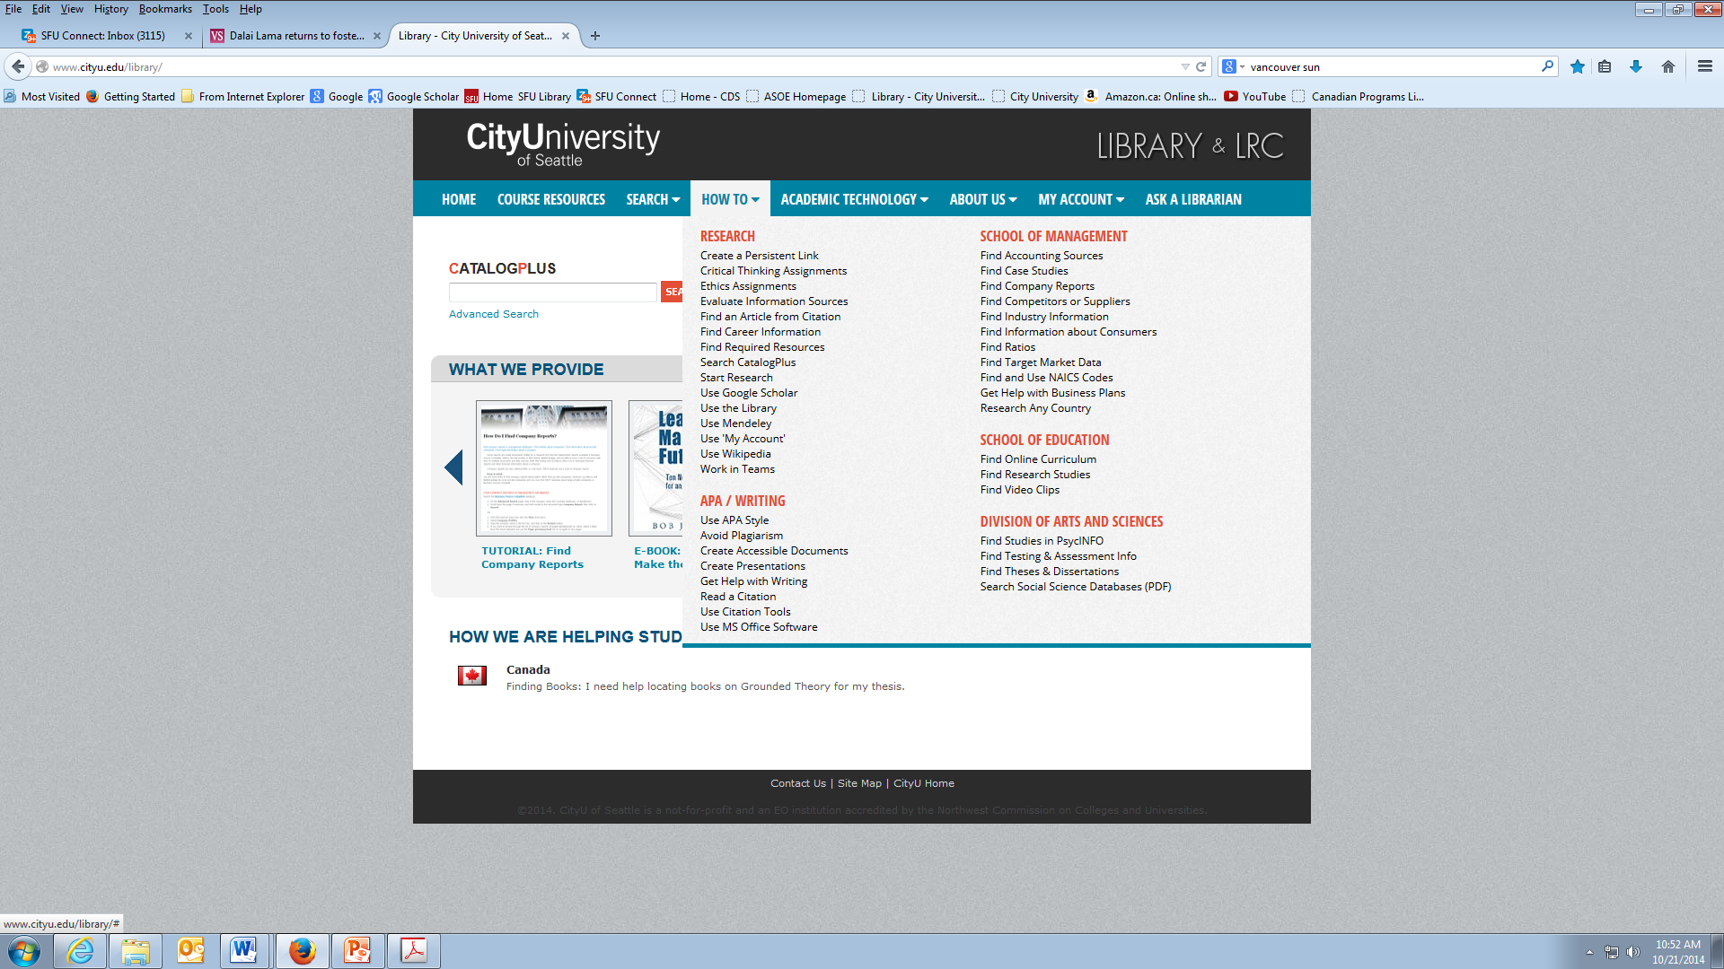
CityU Resources
The CityU library has a LOT of materials on writing

Slide 57
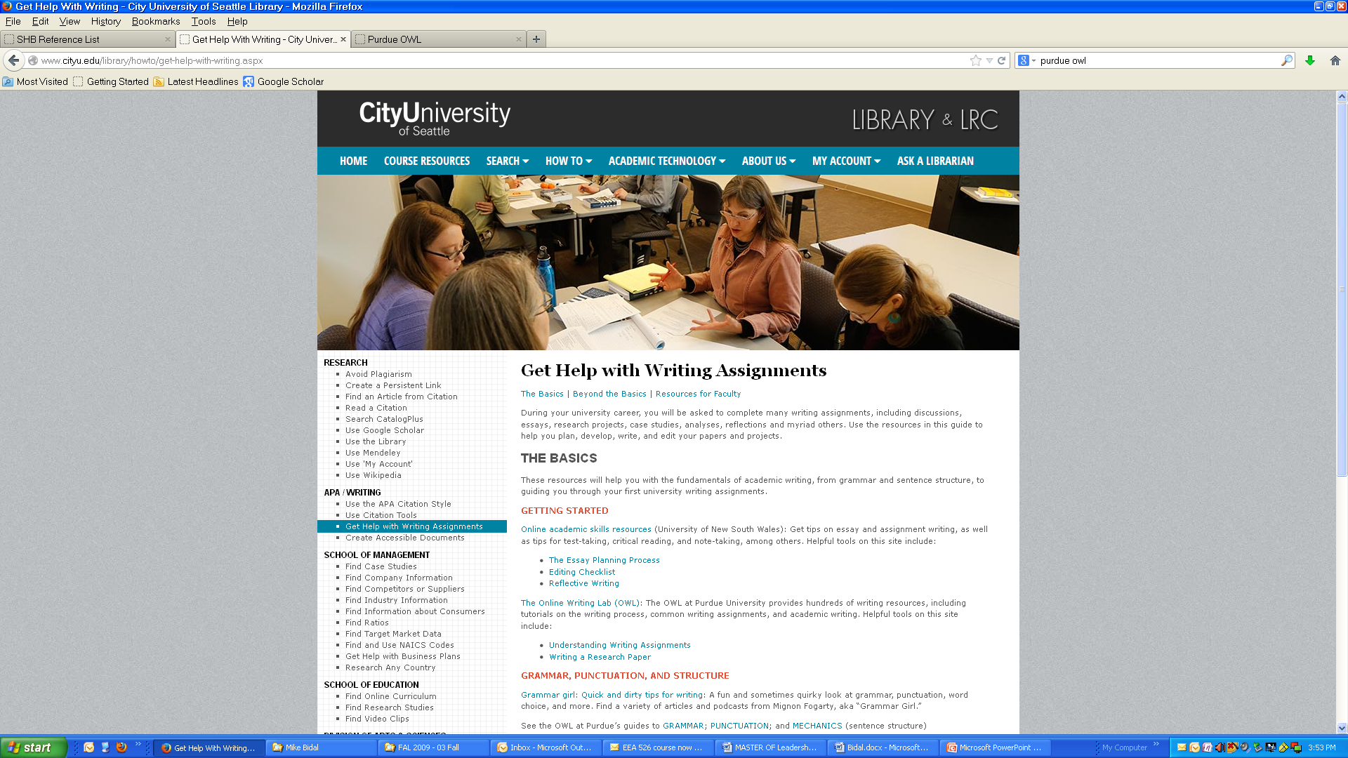

Slide 58
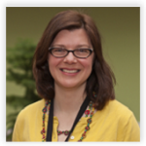
Jennifer Bodley, librarian goddess
She can do anything! You can reach her via 1-800 number, through email, via online chat
Jennifer Bodley Librarian 206.239.4549 800.526.4269
jjbodley@cityu.edu

Slide 59
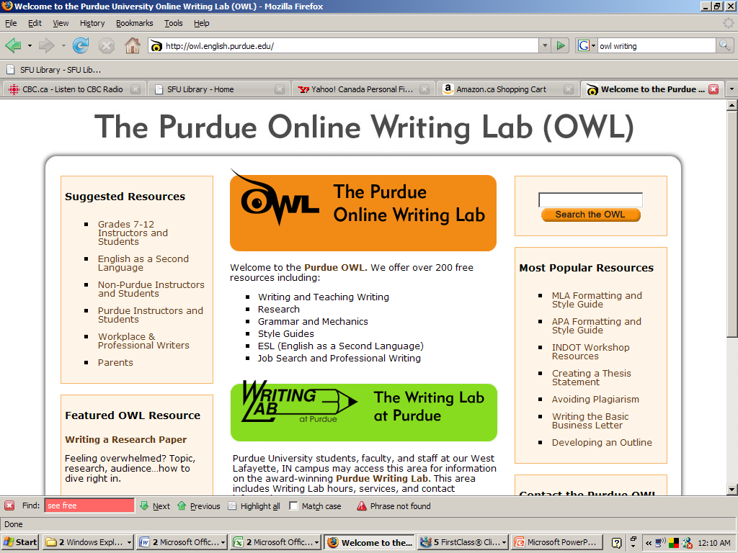

Slide 60
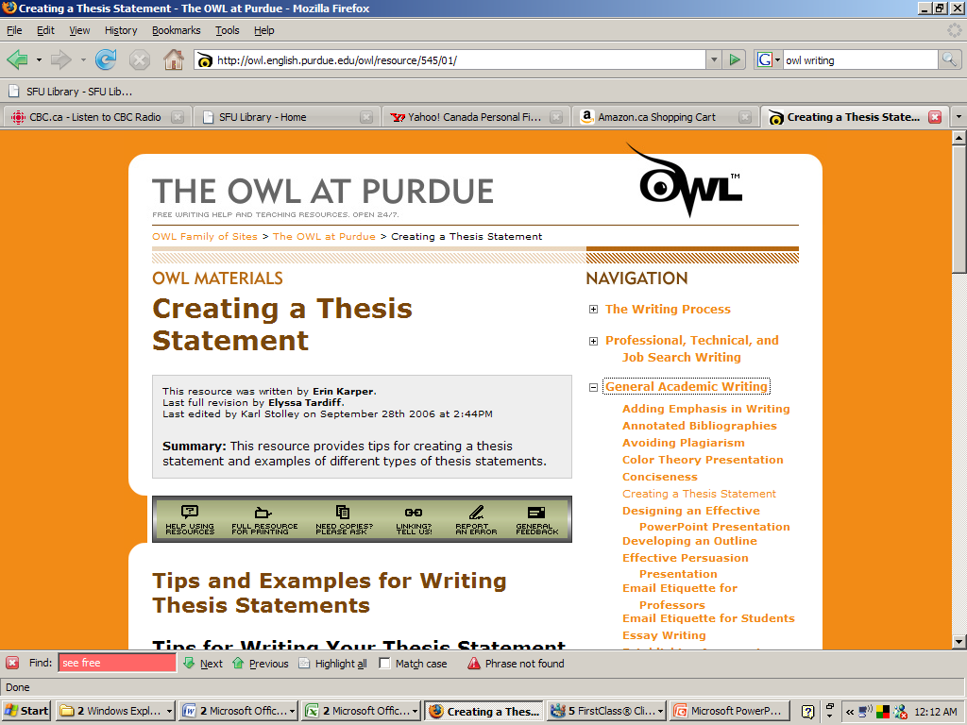

Slide 61
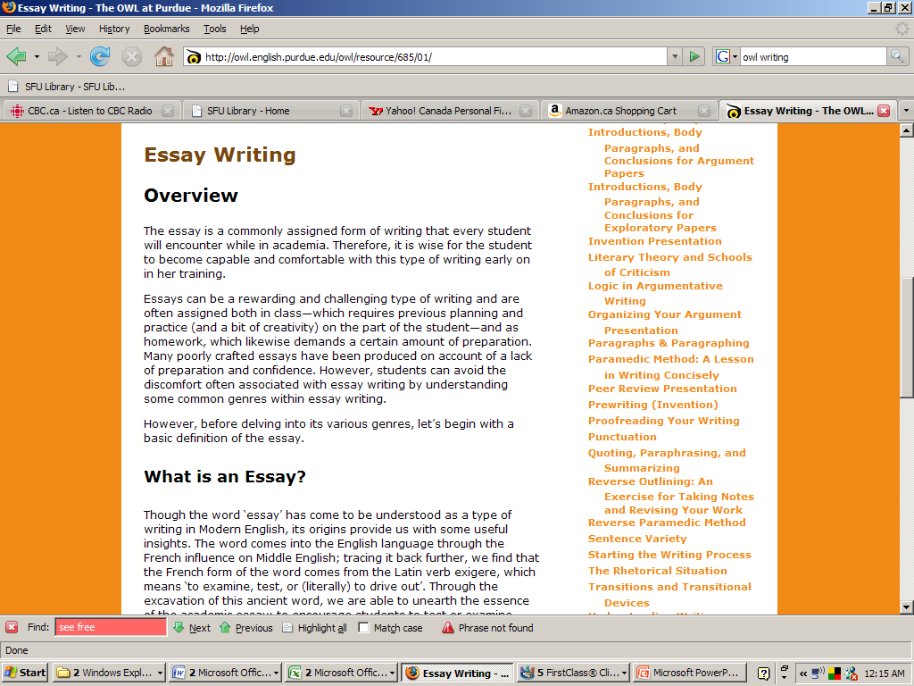

Slide 62
APA Concerns
We have to cite our sources properly and format our reference list properly
APA issues are not a big deal!
Use Mendeley—it will save you SO much time!
Trust me on this, please!
We will look at some journal articles to show some examples that will illustrate some of the things you need to know for citing …

Slide 63
Plagiarism
Plagiarism, a violation of scholastic honesty, is defined as:
“Presenting another person’s work as your own. Paraphrasing or condensing ideas from another person’s work without proper citation. Failing to document direct quotations with a proper citation. Failing to cite all sources from which data, examples, ideas, word or theories are found.”
Plagiarism can be intentional or inadvertent. The information and links here are to help you learn to cite sources correctly and avoid unintentional plagiarism.

Slide 64
Plagiarism
Don’t do it!

Slide 65
Plagiarism
Don’t do it!
Ever!

Slide 66
Plagiarism
Don’t do it!
Ever!
There’s no need to!

Slide 67
Why is plagiarism considered to be such a serious offence?
In academic culture new ideas “belong” to their creator. Proper and complete citations assist individual creators to retain ownership rights to their work. When sources are not properly acknowledged, a creator's right of ownership is threatened. Secondly, citing sources enables readers of your paper to review the research that you read when initially preparing your paper, and to therefore trace the path of your argument more effectively.
At the university level plagiarism can undermine the credibility of research done at academic institutions, and therefore universities have little tolerance for this type of behaviour.

Slide 68
Plagiarism
Plagiarism is usually really easy for an instructor to catch, using Google and Turnitin.com
There is plenty of material about plagiarism and how to avoid it from the CityU Library website
Go here

Slide 69
Plagiarism
Let’s see if we can find this sentence through a simple Google search
"Relational leadership is about recognizing the heteroglossic nature of dialogue"

Slide 70
A plagiarized version:
Original:
Students frequently overuse direct quotation in taking notes, and as a result they overuse quotations in the final [research] paper. Probably only about 10% of your final manuscript should appear as directly quoted matter. Therefore, you should strive to limit the amount of exact transcribing of source materials while taking notes. Lester, James D. Writing Research Papers. 2nd ed. (1976), pp. 46-47.
Plagiarized Version:
Students often use too many direct quotations when they take notes, resulting in too many of them in the final research paper. In fact, probably only about 10% of the final copy should consist of directly quoted material. So it is important to limit the amount of source material copied while taking notes.

Slide 71
What are the consequences of plagiarism?
Depending on the case, penalties for academic dishonesty at CityU are very severe and range from reprimand and having to re-do an assignment, to receiving a zero on an assignment, to failure in a course, to suspension. We strongly suggest that you don't do it!
“All members of the University community share the responsibility for the academic standards and reputation of the University. Academic honesty is a cornerstone of the development and acquisition of knowledge. Academic honesty is a condition of continued membership in the university community.”

Slide 72
Common Concerns
That and Who
People that work…..
I will fight for students that are in need of basic life necessities.
And those that are there tend to have a great
I am drawn to a leader that starts conversations

Slide 73
Common Concerns
That and Who
People who work…..
I will fight for students who are in need of basic life necessities.
And those who are there tend to have a great
I am drawn to a leader who starts conversations
Use “that” for objects and “who” for people

Slide 74
Common Concerns
Dangling prepositions/modifiers
“It is important to keep challenging myself and finding new areas of ‘discomfort’ to stretch myself through”
“After reading the original study, the article remains unconvincing.”
“After reading the great new research, the professor’s lecture based on it is sure to be exciting.”

Slide 75
Common Concerns
Don’t abbreviate:
“proj” for “project”
Avoid using contractions: won’t, don’t, wouldn’t
“Will not,” “do not,” “would not”—more formal

Slide 76
Common Concerns
Subject-verb agreement:
“little people who needs help”
“With a leader who establishes themselves”

Slide 77
Common Concerns
Spell out numbers that are ten or less; that is, less than 11.

Slide 78
That’s it!
Thanks for your attention!

